Slide 1
MULTIPLE INTEGRALS
Summation in two directions
Double integrals
Triple integrals
Applications
Alternative notation
Determination of areas by multiple integrals
Determination of volumes by multiple integrals

Slide 2
Summation in two directions
Double integrals
Triple integrals
Applications
Alternative notation
Determination of areas by multiple integrals
Determination of volumes by multiple integrals

Slide 3
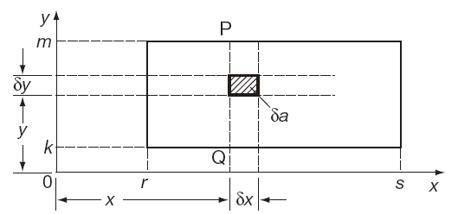
Summation in two directions
The area δa of the shaded portion of the rectangle bounded by the lines x = r, x = s, y = k and y = m is given as:
The area of the vertical strip PQ is then:

Slide 4
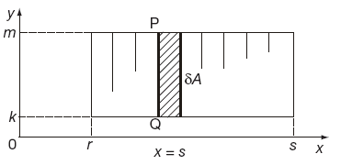
Summation in two directions
The area of the rectangle is then the sum of all such strips:
If now, δy → 0 and δx → 0 the area of
the rectangle is given as:

Slide 5
Summation in two directions
Now:

Slide 6
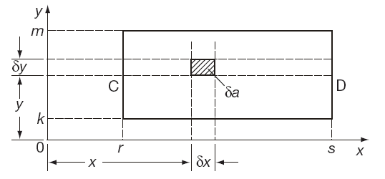
Summation in two directions
Working another way where, again, the area δa of the shaded portion of the rectangle bounded by the lines x = r, x = s, y = k and y = m is given as:
The area of the horizontal strip CD is then:

Slide 7
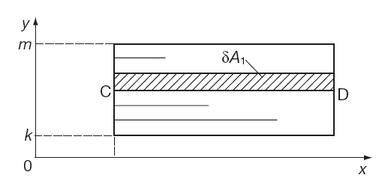
Summation in two directions
The area of the rectangle is then the sum of all such strips:
If now, δy → 0 and δx → 0 the area of
the rectangle is given as:

Slide 8
Summation in two directions
Now:
So here, the order of integration does not matter

Slide 9
Summation in two directions
Double integrals
Triple integrals
Applications
Alternative notation
Determination of areas by multiple integrals
Determination of volumes by multiple integrals

Slide 10
Double integrals
The expression:
is called a double integral and indicates that f (x, y) is first integrated with respect to x and the result is then integrated with respect to y
If the four limits on the integral are all constant the order in which the integrations are performed does not matter.
If the limits on one of the integrals involve the other variable then the order in which the integrations are performed is crucial.

Slide 11
Summation in two directions
Double integrals
Triple integrals
Applications
Alternative notation
Determination of areas by multiple integrals
Determination of volumes by multiple integrals

